Slide 1


3 base project Traffic light circuit design
Students perform : Tran Van Thanh
Class: 20CE
Instructor: TS. Nguyen Vu Anh Quang

Slide 2

Some main components in the circuit
PROJECT INTRODUCTION
01
02
Result
Algorithm flowchart
03
04
CONTENT
Conclusion
05

Slide 3
PROJECT INTRODUCTION
01

Slide 4

PROJECT INTRODUCTION
Đèn tín hiệu giao thông là công cụ không thể thiếu trong hệ thống giao thông Việt Nam:
Giảm ùn tắc giao thông tại các nút giao, ngã ba.
Hạn chế tai nạn giao thông.

Slide 5
The main components
02

Slide 6

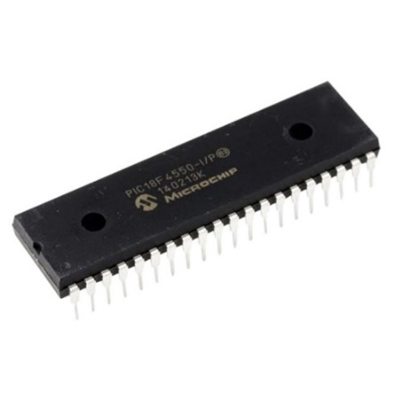
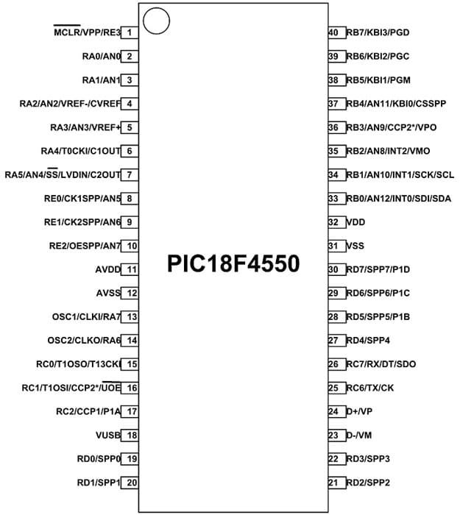
Main ingredient
*PIC18f4550:
Manufactured by Microchip in the pic family.
Is an 8-bit microcontroller, 32KB program memory, 256B EEPROM,2KB SRAM.

Slide 7
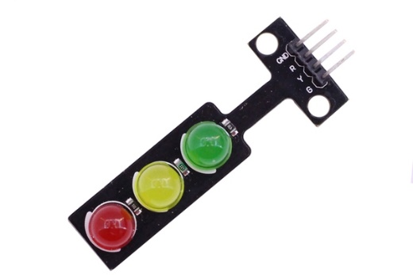
Main ingredient
*Traffic light circuit:
Available in 3 colors: red, yellow, blue
Input voltage: 5V

Slide 8
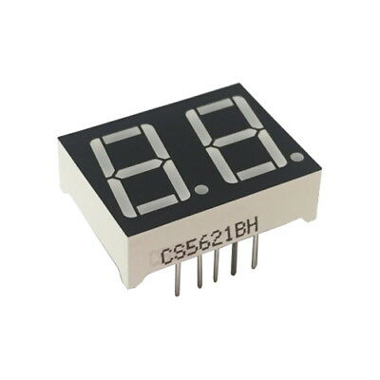
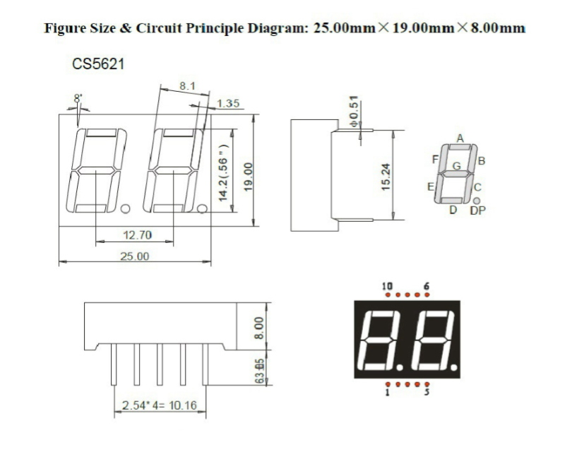
Main ingredient
*Led 7 segment:
Display numbers from 1-99
Color: Red
Number of pins: 10

Slide 9
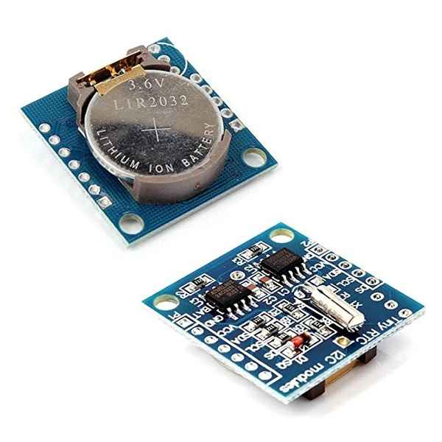
Main ingredient
*Module RTC DS1307:
Real-time reading
Using I2C communication with pic

Slide 10
Algorithm flowchart
03

Slide 11
Begin
Bắt đầu
Read time from RTC DS1307
Đọc thời gian từ RTC DS1307
Check the time
Time = 23h - 4h
Y
Night mode
N
Time = 5h - 22h
Y
Day mode
N

Slide 12
Result
04

Slide 13
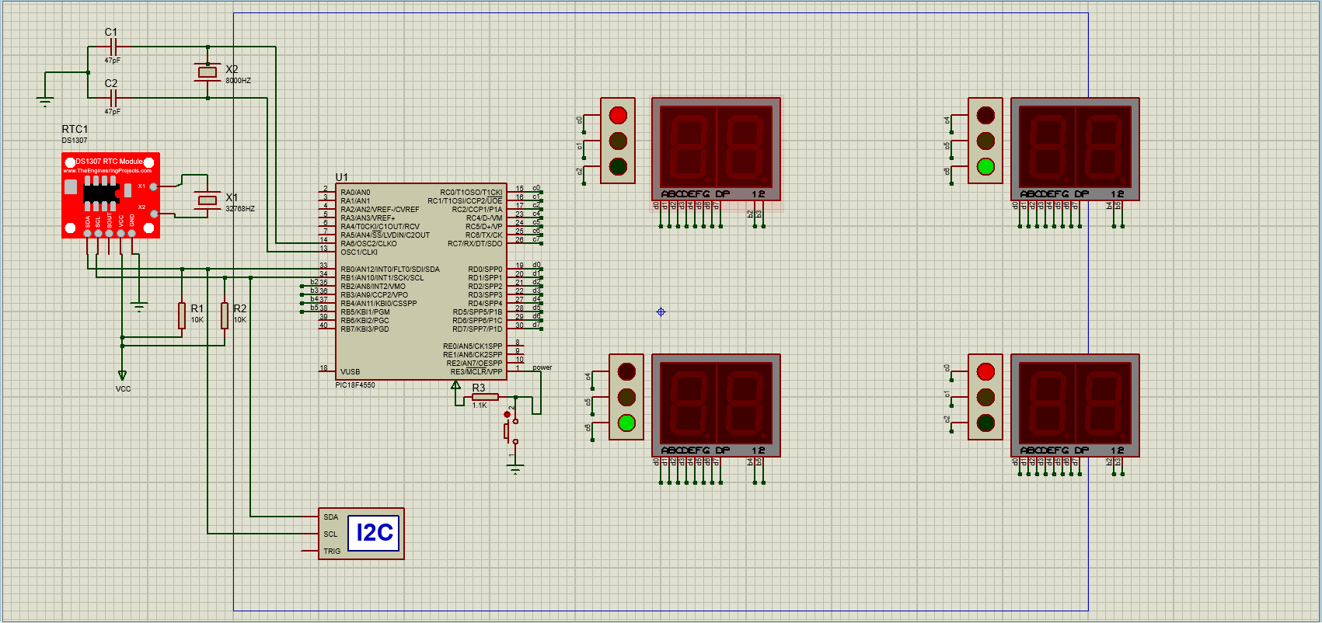
Circuit simulation

Slide 14
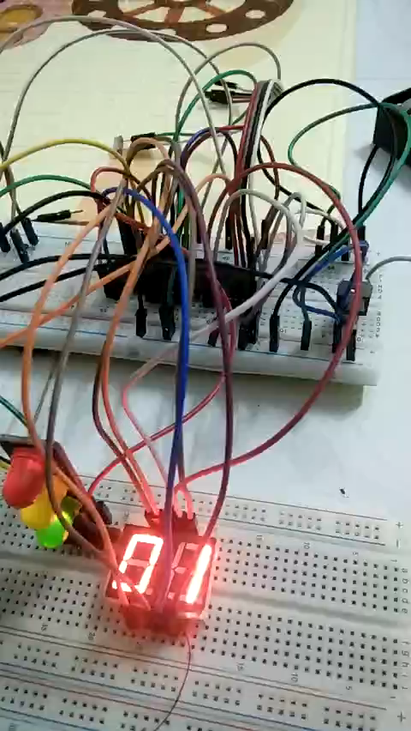
Video demo

Slide 15
CONCLUSION
Learn more skills about programming microcontrollers and electronic circuits.
Development:
- Research and develop to be able to apply the product into practice.

Slide 16

THANK YOU FOR WATCHING

